Slide 1
Lab 3 Multiplication and Division
CG3207 Group 17

Slide 2
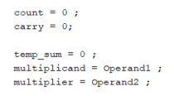
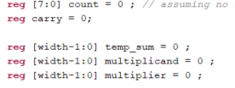
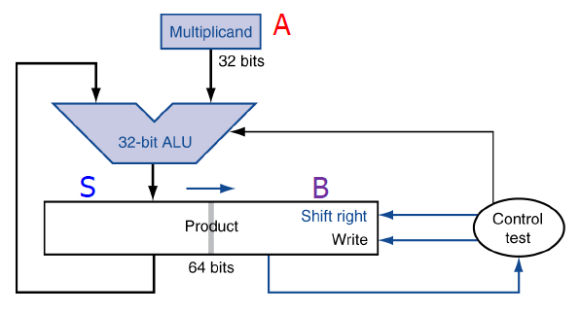
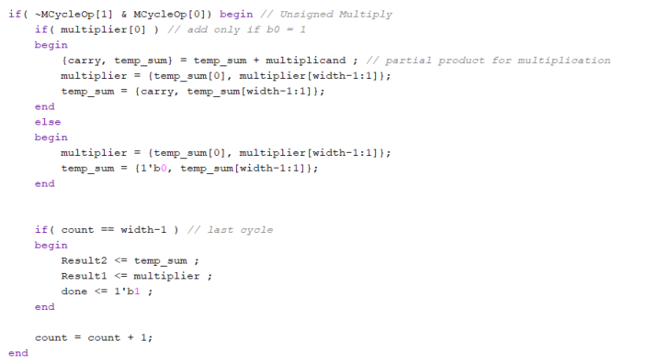
Improved Unsigned Sequential Multiplier
Check if multiplier[0] is equal to 1 or 0
This will determine if addition of S + A is required
After N cycles, result 2 = MSW of product, result 1 = LSW.

Slide 3
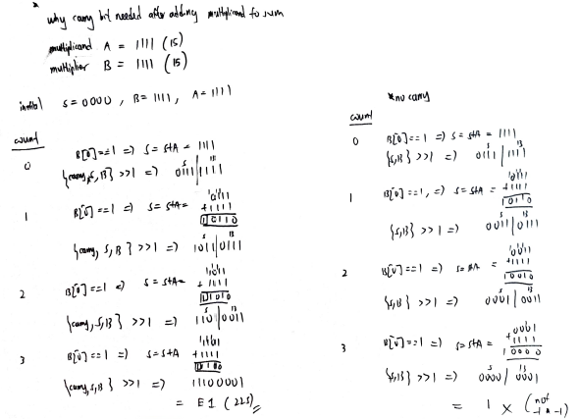
Trace Unsigned Multiply
This is a trace of an unsigned multiplication using a carry bit (right) and not using a carry bit (left)
As the trace shows, the presence of carry bit concatenate with S and B changes the answer.

Slide 4


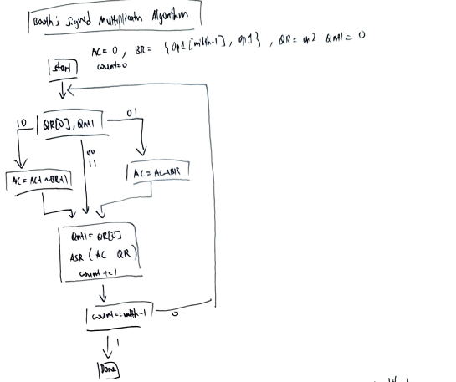
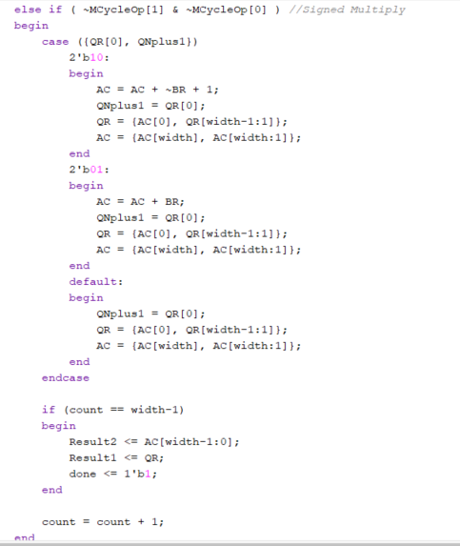
Implementation of Booth’s Algorithm
First check if QR[0] and reg QNPlus1
Depending on answer, either add or subtract, then arithmetic shift right.
Continue cycle until count == width-1 is completed.

Slide 5
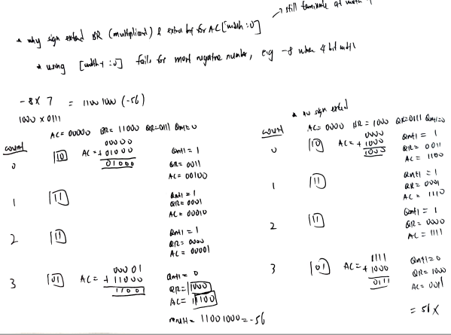
Trace Booth’s Algorithm
*sign extend
The use of sign extend to pad the number of bits of BR and AC is shown that it can lead to a different answer when dealing with the most negative number as multiplicand

Slide 6
Improvements added
32 bit ALU
The use of Booth Algorithm for Signed Multiplication.
Booth algorithm gives a procedure for multiplying binary integers in signed 2’s complement representation in efficient way.
Benefits : less number of additions/subtractions required

Slide 7
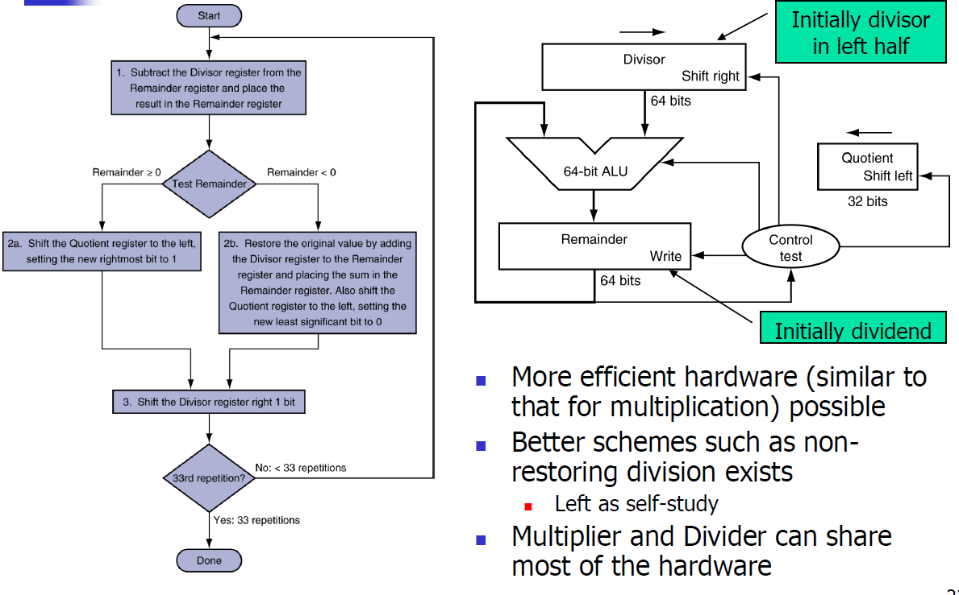

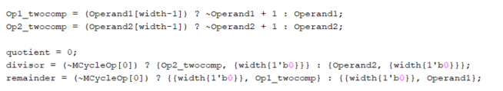
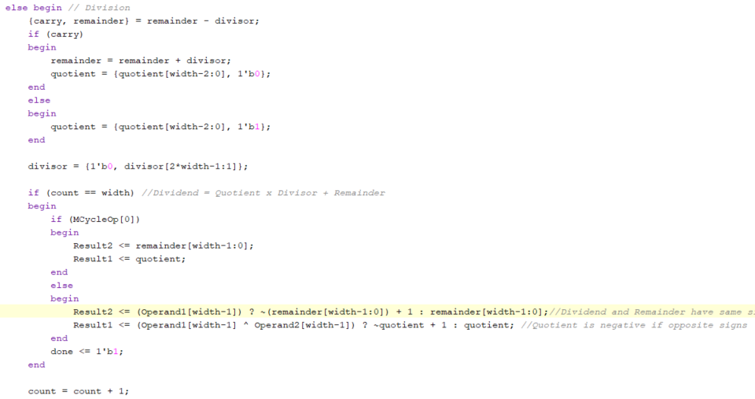
Restoring Division
Implemented as per lecture content

Slide 8
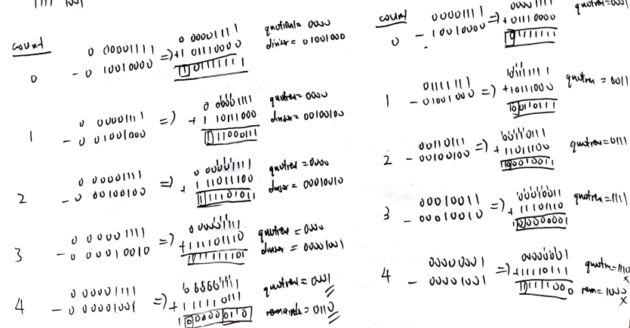
Trace Restoring Division
*carry

